Slide 1

Department of Electronics and Communication Engineering
Design of an Area and Power Optimized Approximate Floating-Point Multiplier Using Brent-Kung Adder
Name of the Guide
Mr. Krishna Saladi
Asst. Prof
Students Name and Roll Numbers
1. D. Harika (218T1A0460)
2. MD. Arsalan (228T5A0418)
3. G. Durga Prasad (218T1A0464)
4. P. Rohini (218T1A0488)

Slide 2
Contents
Abstract
Introduction
Literature survey
Problem statement
Existing Methodology
Proposed technique
Results
Future scope
Conclusion
References

Slide 3
Abstract
This work presents a novel design of an approximate floating-point multiplier, reducing power consumption and chip area, which is ideal for energy-constrained applications such as embedded systems, image processing, and machine learning.
The architecture applies approximation in the mantissa multiplication stage to simplify logic complexity, while integrating a Brent-Kung parallel prefix adder for efficient exponent addition and normalization, balancing speed and hardware usage.
Simulation results demonstrate significant improvements in power and area metrics with only a minor impact on computational accuracy, validating the design's effectiveness for applications that can accommodate slight numerical approximations.

Slide 4
Introduction
Introduces an Approximate Floating-Point Multiplier with a Frequency and Precision Controller operating across three clock domains (CLK1: high speed/low precision, CLK2: balanced, CLK3: high precision/low speed) to dynamically trade off power, speed, and accuracy.
The multiplier integrates a Brent-Kung Adder, which minimizes the logic complexity of carry propagation compared to traditional designs (e.g., Carry Lookahead Adders), resulting in reduced chip area and power consumption.
Developed in Verilog HDL and synthesized on Xilinx Vivado, the design demonstrates significant reductions in area and power consumption while maintaining acceptable accuracy for DNN inference in resource-constrained edge applications.

Slide 5
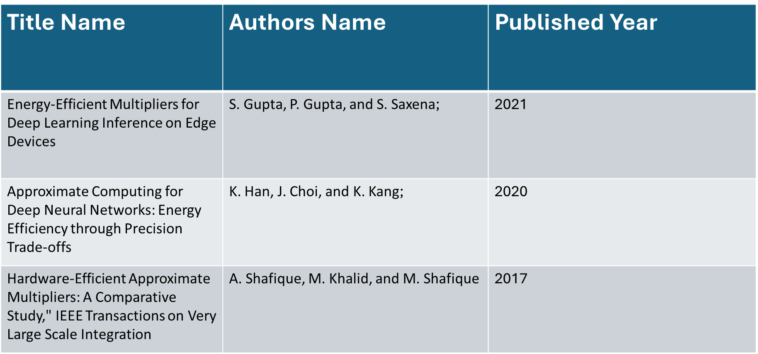
Literature Survey

Slide 6
Problem statement
Conventional floating-point multipliers, essential for DNN inference and other high-precision tasks, typically incur significant power consumption and chip area, challenging the deployment in resource-constrained edge and embedded systems.
Achieving high accuracy in floating-point operations usually requires complex hardware, while reducing complexity through approximation risks unacceptable errors. This project addresses the need to balance reduced power/area with acceptable computational accuracy.
There is a critical need for a design that dynamically adjusts precision and clock frequency to suit varying application demands. Integrating efficient error correction and optimized adders, such as the Brent-Kung adder, into such adaptive architectures poses a significant challenge that this work .

Slide 7

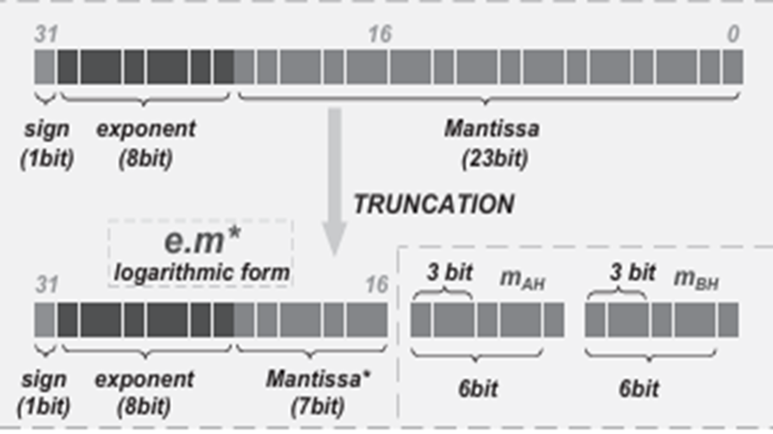
IEEE-754 floating-point format:

Slide 8
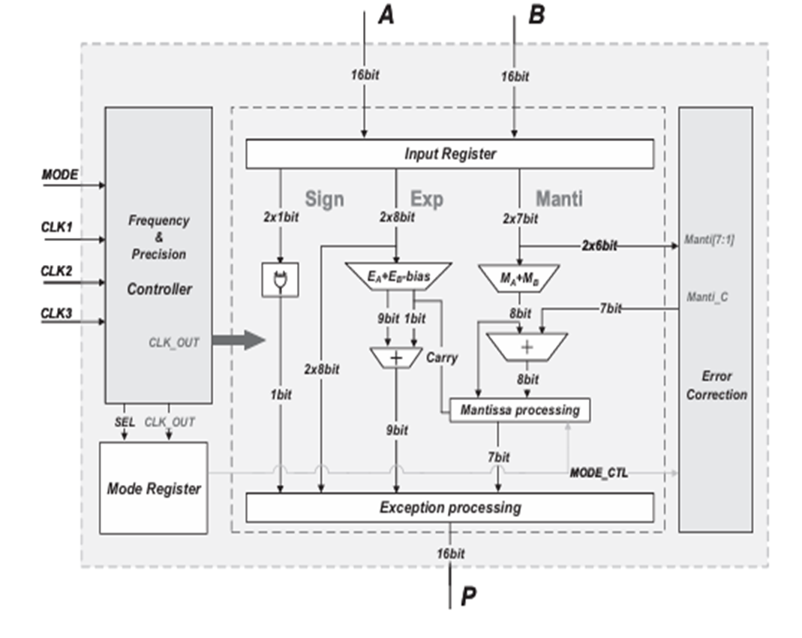
Existing Methodology

Slide 9
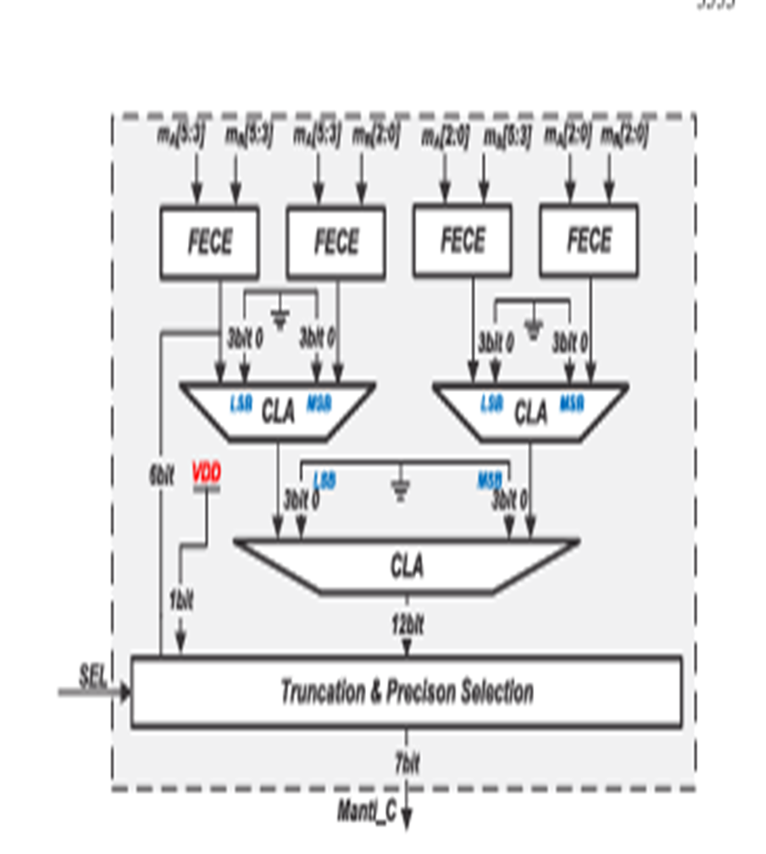
Error Correction Model:

Slide 10
Existing Methodology
Logarithmic Approximation Floating point :
This method transforms multiplication into addition by applying logarithmic functions, thereby reducing hardware complexity and power usage. However, it introduces approximation errors that need management.
Approximate Booth Encoding:
Utilizing simplified Booth encoding schemes, this approach decreases the number of partial products in multiplication, leading to lower power consumption and faster computations. The trade-off is a potential increase in computational errors.
Truncation Techniques:
By truncating less significant bits of operands, truncation methods reduce the complexity of multiplication operations. While this results in faster processing and reduced power usage, it can also lead to a loss of precision

Slide 11



Slide 12
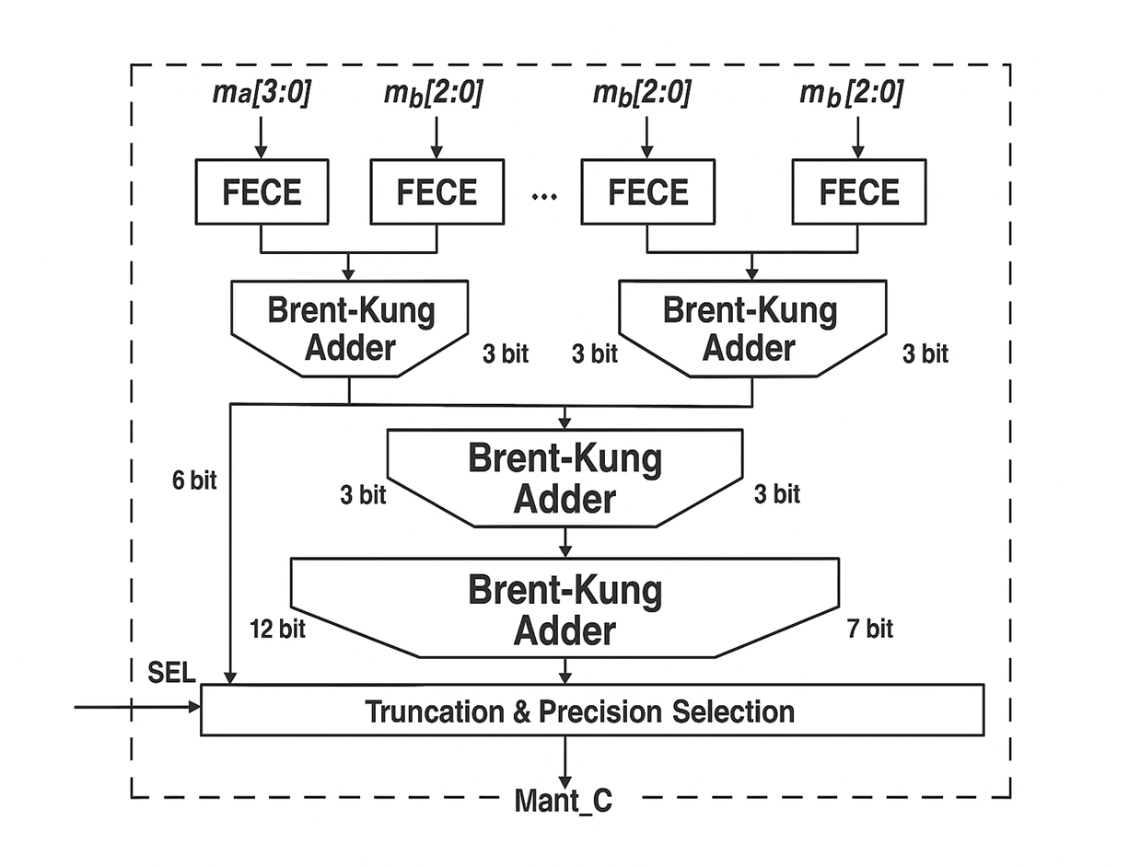
ERROR CORRECTION MODEL:

Slide 13
Proposed Methodology
The design begins with the decomposition of the IEEE-754 floating-point format, focusing on the multiplication of mantissas and the addition of exponents. Approximation techniques are applied in the mantissa multiplication stage to simplify logic and reduce power.
A Brent-Kung parallel prefix adder is used for exponent addition and normalization. This adder is chosen for its reduced logic depth and smaller area compared to traditional adders, which helps to improve the overall speed and efficiency of the multiplier unit.
The architecture includes a Frequency and Precision Controller that supports three clock domains (CLK1, CLK2, CLK3). This controller allows the system to dynamically switch between precision modes at runtime, enabling trade-offs between speed, power, and accuracy.

Slide 14
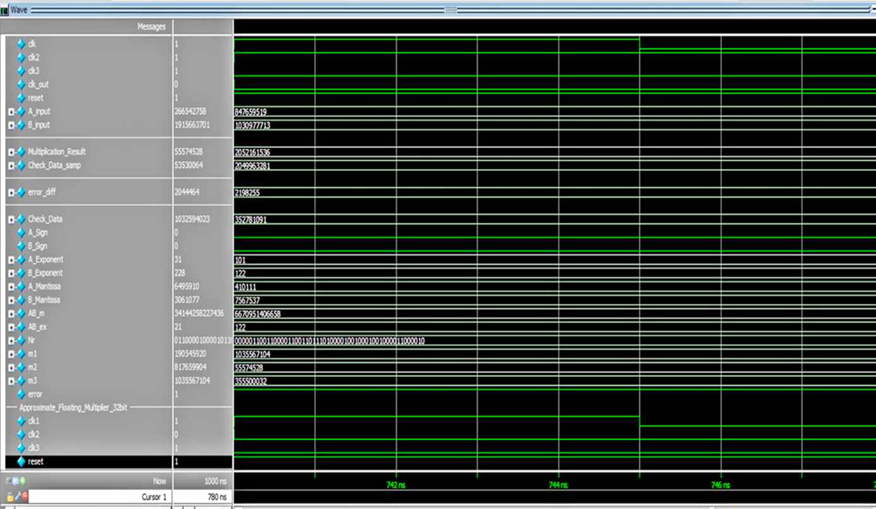
Results Existing methodology

Slide 15
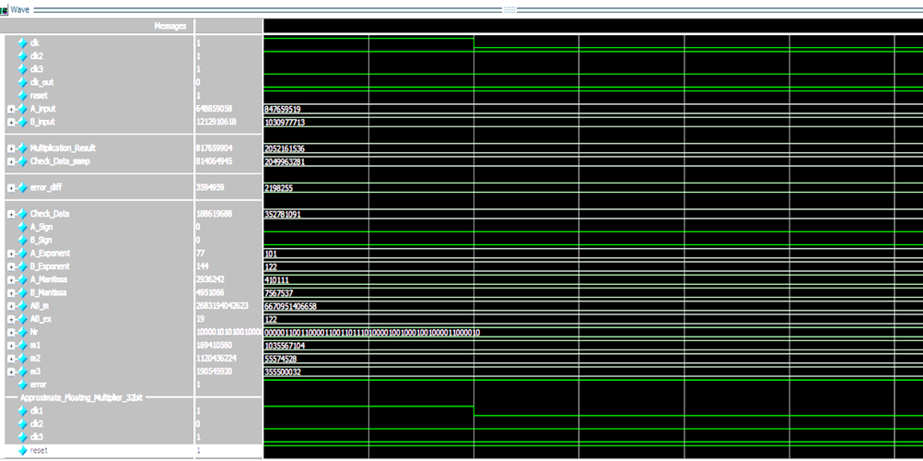

Slide 16
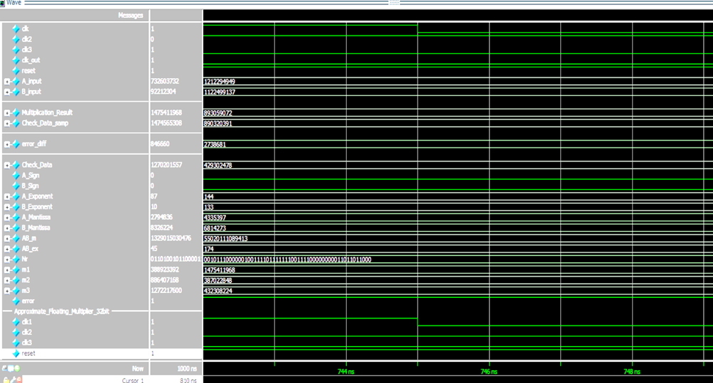

Slide 17
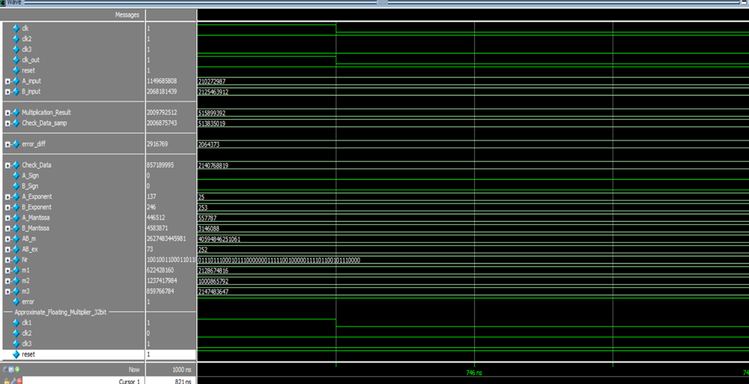
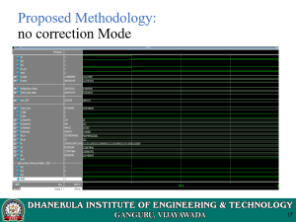

Proposed Methodology: no correction Mode

Slide 18
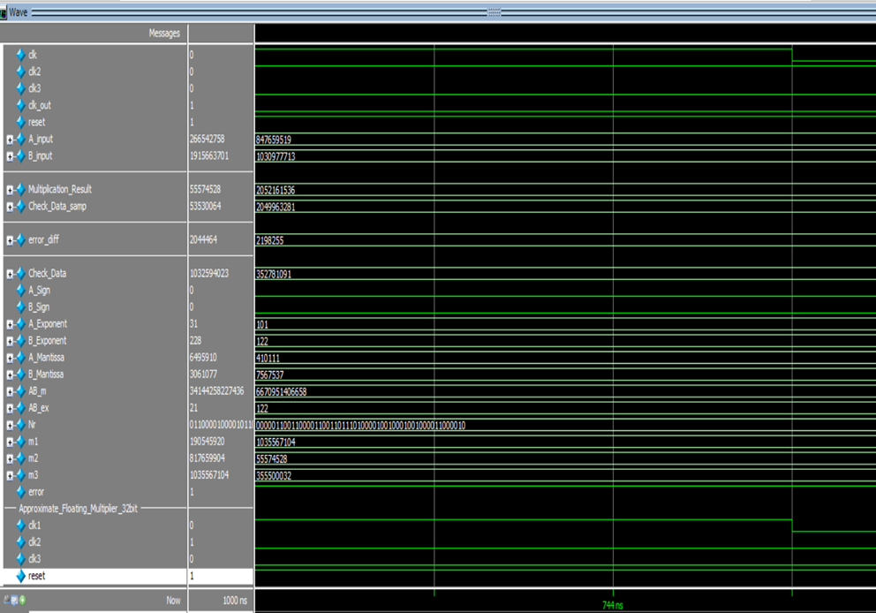
Low Precision Mode:

Slide 19
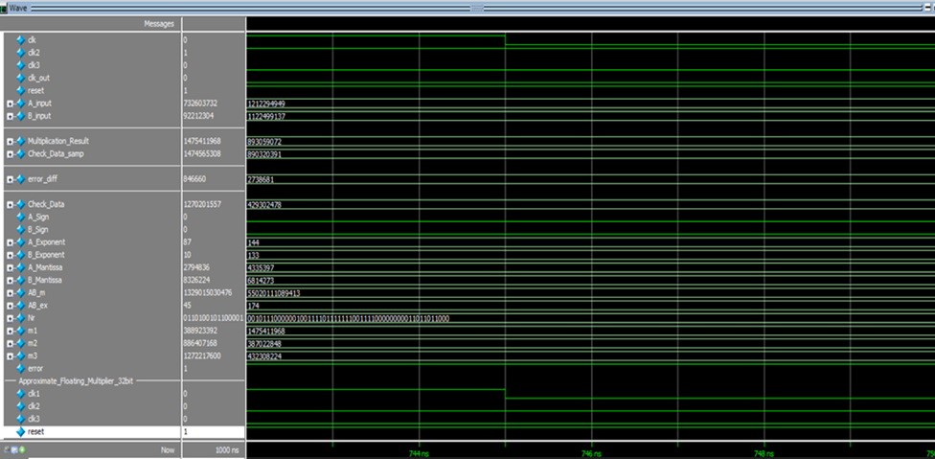
High Precision Mode:

Slide 20
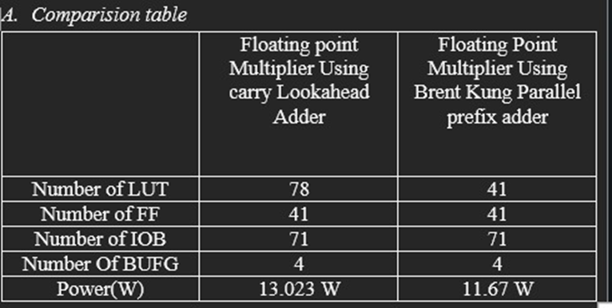

Slide 21
Advantages:
The frequency and precision controller provides adaptive trade-offs, allowing for seamless transitions between high accuracy and low energy consumption, optimizing performance for different applications.
The power efficiency of the design is enhanced by a reconfigurable clock system, which dynamically scales precision and clock speed to significantly reduce overall power consumption.
The approximate computing approach minimizes unnecessary switching activity in the hardware, further lowering dynamic power consumption and enhancing the overall energy efficiency of the design

Slide 22
Applications:
It is used in deep learning and AI acceleration and it enhances the efficiency in neural network inference and machine learning applications and also it is used in edge computing device and IOT devices to optimize the power efficient processing for smart devices
it is used in digital signal processing it provides the audio processing ,image enhancement and communication systems and it is also used in high performance computing it improves the speed and efficiency in scientific and large scale computations simulations
It is used in cryptography and security it is also efficient arithmetic operations for secure encryption and decryption processes and also in 5g communications it optimizes for signal processing in wireless networks reducing latency it also supports in CT scan

Slide 23
Conclusion
The proposed approximate floating-point multiplier successfully reduces power consumption and chip area, making it well-suited for energy-constrained systems such as edge computing and embedded platforms.
The dynamic frequency and precision control mechanism adds adaptability to the design, enabling real-time trade-offs between accuracy and efficiency. This flexibility supports diverse application needs, especially in systems with variable workload conditions.
Integration of the Brent-Kung adder has shown to improve computational speed and reduce logic complexity. This optimization enhances the overall performance of exponent operations while contributing to the compactness of the architecture.

Slide 24
References
K. Han, J. Choi, and K. Kang, "Approximate Computing for Deep Neural Networks: Energy Efficiency through Precision," IEEE Transactions on Neural Networks and Learning Systems, vol. 31, no. 12, 2020, pp. 5707-5719.
R. Zimmermann, "Brent-Kung Adder: An Efficient Architecture for Low-Area Arithmetic Circuits," IEEE Transactions on Computers, vol. 42, no. 2, 1993, pp. 259-269.
H. Jiang, J. Han, and F. Lombardi, "Error-Tolerant Floating-Point Arithmetic: Design and Application in Energy-Constrained Systems," IEEE Transactions on Computers, vol. 60, no. 2, 2011, pp. 87-96.
P. Judd, J. Albericio, and T. Hetherington, "Reconfigurable Clock Systems for Low-Power VLSI: Balancing Frequency and Precision," ACM/IEEE Design Automation Conference, 2016, pp. 123-130.
A. Shafique, M. Khalid, and M. Shafique, "Hardware-Efficient Approximate Multipliers: A Comparative Study," IEEE Transactions on Very Large Scale Integration (VLSI) Systems, vol. 25, no. 10, 2017, pp. 1-11.
S. Gupta, P. Gupta, and S. Saxena, "Energy-Efficient Multipliers for Deep Learning Inference on Edge Devices," IEEE Transactions on Neural Networks, vol. 32, no. 2, 2021, pp. 488-497.

Slide 25
Thank You

